Slide 1

The NBA: Is there an age curve?
Dec 2021
Christina Rhees

Slide 2
To prepare for model, data was cleaned and formatted
Player Evaluation Metrics, player Age and Position were webscraped from Basketball-Reference.com
  Only those who played for five years or longer were kept in the dataset
Exact age was calculated for each player at the end of each season based on birth dates and season endings
Player Positions were simplified to the current 5 positions.
Duplicates and null values for any of the player Evaluation Metrics were removed.

Slide 3
Splines Models were compared using 5 different Player Evaluation Metrics.
Win Shares, Win Shares/48, Box Plus Minus, Player Efficiency Rating, and Value Over Replacement Player were all scraped from Basketball-Reference.com
5-Knot Linear splines models were created for each metric with interactions between Exact Age and Player Position.
Through observation of coefficients and visuals, VORP and WS appear to be the only PEM that have a peak in their models.

Slide 4
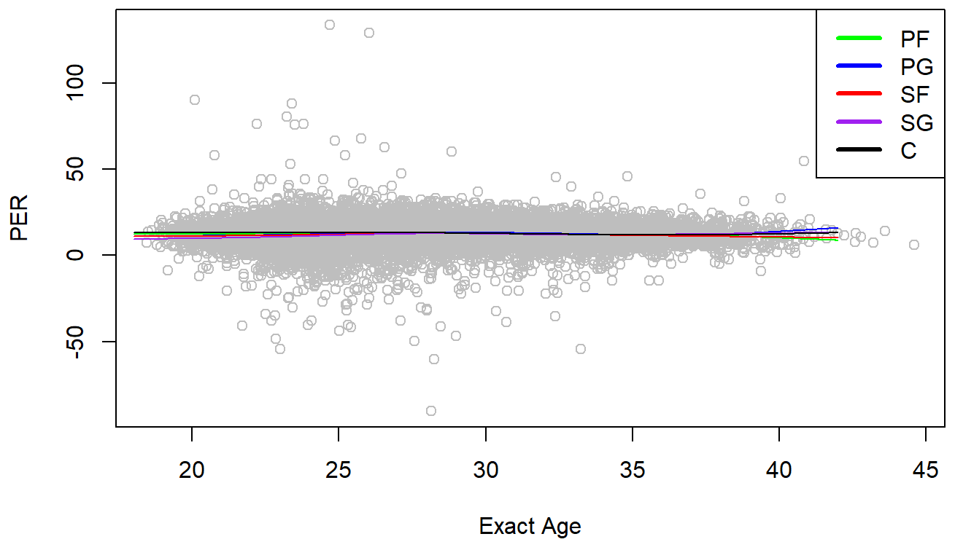
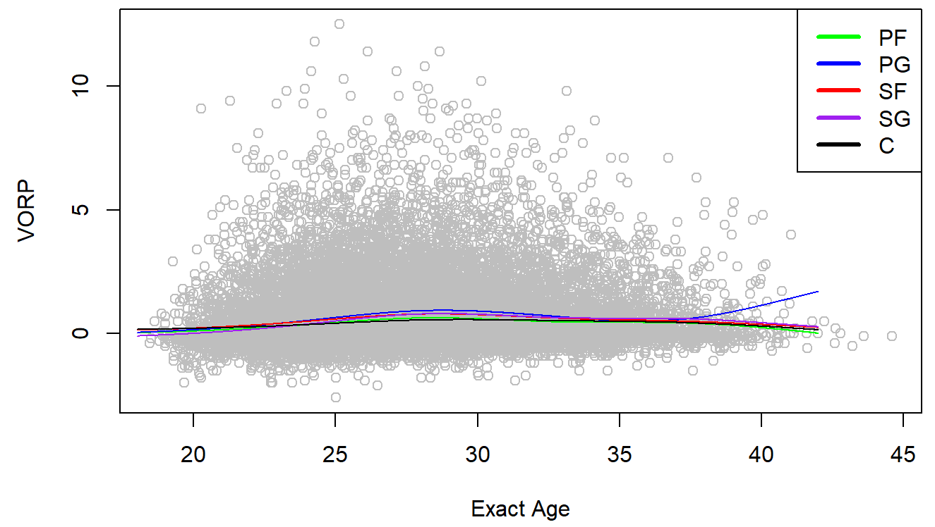
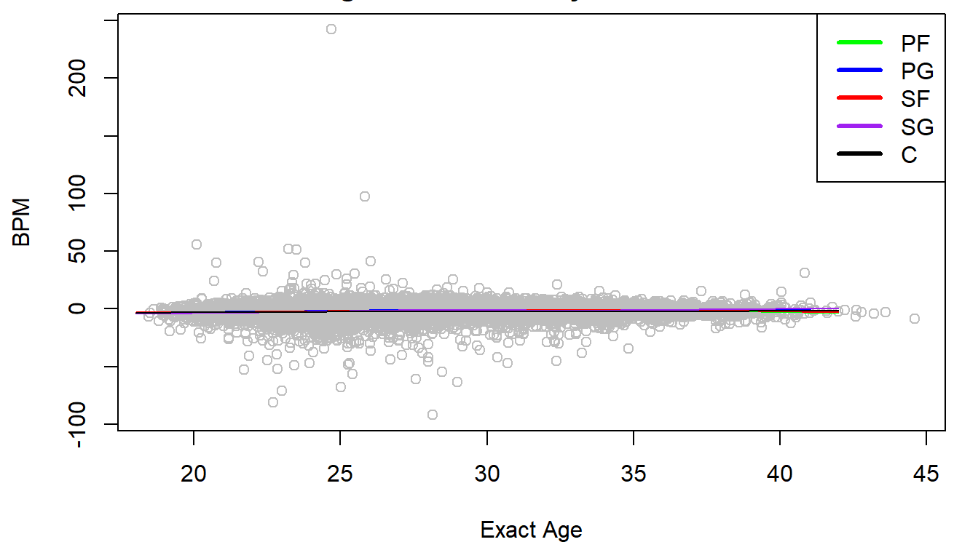
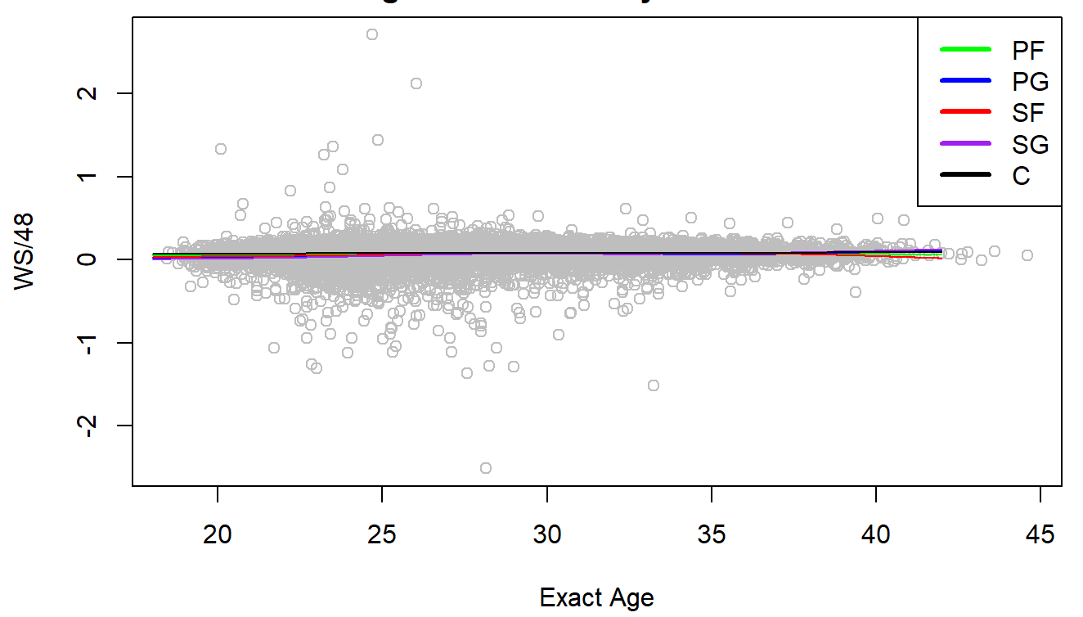

Slide 5
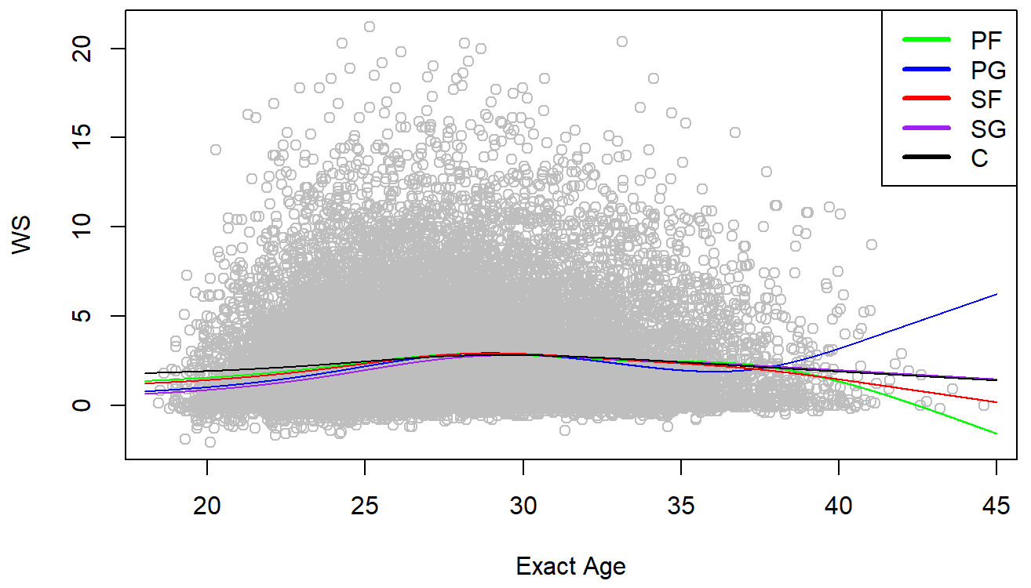
Initial splines model confirmed no interaction between Exact Age and Position
ANOVA testing between Position Models of each PEM and observation of visuals indicated no significant interaction between position and age.

Slide 6
Multiple splines models were created and compared
A quadratic splines glm was produced and compared to the 5-knot model through AIC value and cross validation comparison.
ROOT MEAN SQUARE ERROR OF GIVEN METRICS
WIN SHARES | TRAINING | TESTING | CROSS VALIDATION | VALIDATION SET | AIC VALUE
5-KNOT | 2.8589 | 2.9096 | 2.8669 | 2.8905 | 103653.04
QUADRATIC | 2.8619 | 2.9075 | 2.8700 | 2.8927 | 103691.7
VORP | TRAINING | TESTING | CROSS VALIDATION | VALIDATION SET | AIC VALUE
5-KNOT | 1.2562 | 1.2735 | 1.2603 | 1.3145 | 69139.04
QUADRATIC | 1.2571 | 1.2729 | 1.2611 | 1.3149 | 69162.97

Slide 7
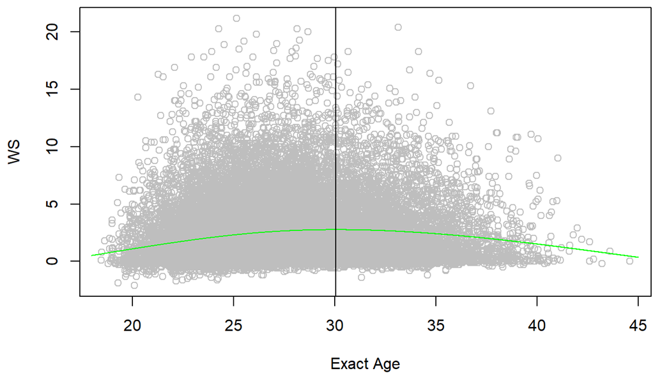
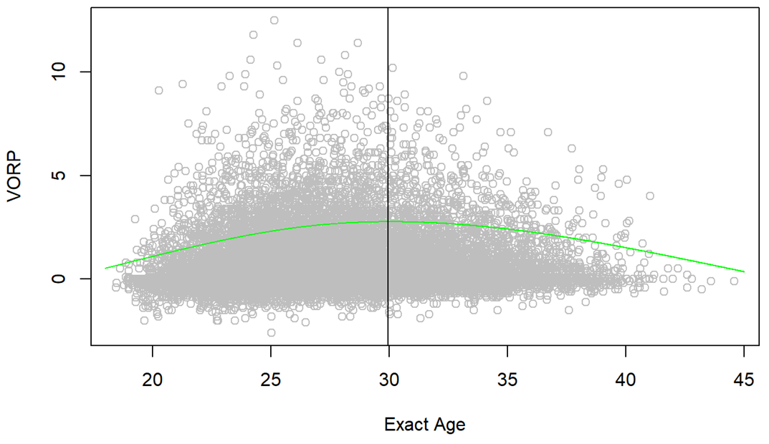
Coefficients were analyzed, curve is statistically significant
Coefficients of the curve of both models were tested, and found to be statistically significant

Slide 8
Players with longer careers show different curve
The original data was filtered to only include players with careers of 15 years or longer, and the same model was fit.
For Win Shares, the maximum prediction value increased dramatically to 6.7 from 2.7, however the age peak also shifted to 28.53 years of age from 30.1 years.
For VORP, a similar trend occurred, the maximum prediction value increased to 2.36 from 0.70, and the age peak shifted to 28.4 years from 29.95.

Slide 9
I would like to create another model using Daily BPM
Daily BPM is calculated using the DARKO model created by Kostya Medvedovsky, and is considered one of the best Player Evaluation Metrics.
There is limited data on Daily BPM across season for each player, which makes it difficult to create a model.

Slide 10
Dealing with Assumptions
There is obvious heteroskedasticity in the models, I would love to find a way to represent it in the future so that predictions can have appropriate confidence bands
There was also likely correlation between observations from the same player, especially for the last model. I would like to learn how to model this as well in the future.

Slide 11
Conclusions
There is no significant interaction between player position and Exact Age for PEMs.
WS and VORP are the only PEMs that show an age curve for NBA Players
30 is the Average Age that an NBA player peaks.
Players with longer careers peaked at an earlier age, but with a higher PEM
There are still multiple factors to include in modeling this data, including correlation between observations and heteroskedasticity.

